Slide 1
Group: B1-07
Automated Barrier and Obstruction Detection System
Group Members : Vinayak Sethi (COE18061)
Shashank Dokania (COE18B067)
Mridul Harish (CED18I034)
Ish Gautam (MFD18I013)

Slide 2
SESSION 1
January 6, 2021
Validate Requirements
Product Specifications
MVP(Minimum Viable Product)
BoP(Bill of Product)

Slide 3
Product Requirements and Working Principle
Detecting the arrival of a train within a set radius.
Signalling this detection to the barriers.
Closing the barriers after receiving a signal.
Detecting the train leaving the crossing.
Signalling this detection to the barriers.
Opening the barrier after receiving a signal.
Working Principle:
2 pairs of IR sensors is used in this project.
If the sensor 1 detects the arrival of the train, microcontroller starts the motor with the help of motor driver in order to close the gate.
The gate remains closed as the train passes the crossing. When the train crosses the gate and reaches second sensor, it detects the train and the microcontroller will open the gate.
The gate becomes closed or open by the rotation of the servo motor.

Slide 4
Minimum Viable Product
Detect the arrival and departure of the train and close/open the barrier in response to it.
Bill of Product
The total bill amounts to Rs 2001.5/-

Slide 5
SESSION 2
January 13, 2021
Project Planning/ Structure
Work Break Down
Assigning Task

Slide 6
Task breakdown
Project Planning
Data collection
Computations related to the product
Design and setup
Assembly of all hardware
To write the code
Experiment it with a rail model
Documentation
Phase 1:
Doing the Maths and completing the computation of major parameters.
Phase 2:
List the final components, purchase them and test them out with a model train.
Phase 3:
Realize the initial prototype

Slide 7
SESSION 3
January 20, 2021
Circuit Diagram/Technical Schematic Diagram
Status of BoM
Purchase finalization

Slide 8
Status of BOM AND Material Finalization
Microcontroller Section
Sensor and Load Section
Components | Price (in INR)
AT89C51 MCU | 65
11.0592 MHz Quartz Crystal | 19
2 x 33pF Ceramic Capacitor | 20
10µF / 16V Electrolytic Capacitor | 24
10KΩ Resistors x 2 | 16
AT89C51 Programmer Board | 749
Total | 893
Components | Price (in INR)
2 x Reflective Type IR Sensor | 70
2 x 1KΩ Resistor | 40
L293D Motor Driver IC | 55
Motor | 70
Total | 235
The gross cost including train set comes to Rs. 1628 /- (approx)

Slide 9
PHASE 1
Doing the Maths and completing the computation of major parameters.

Slide 10
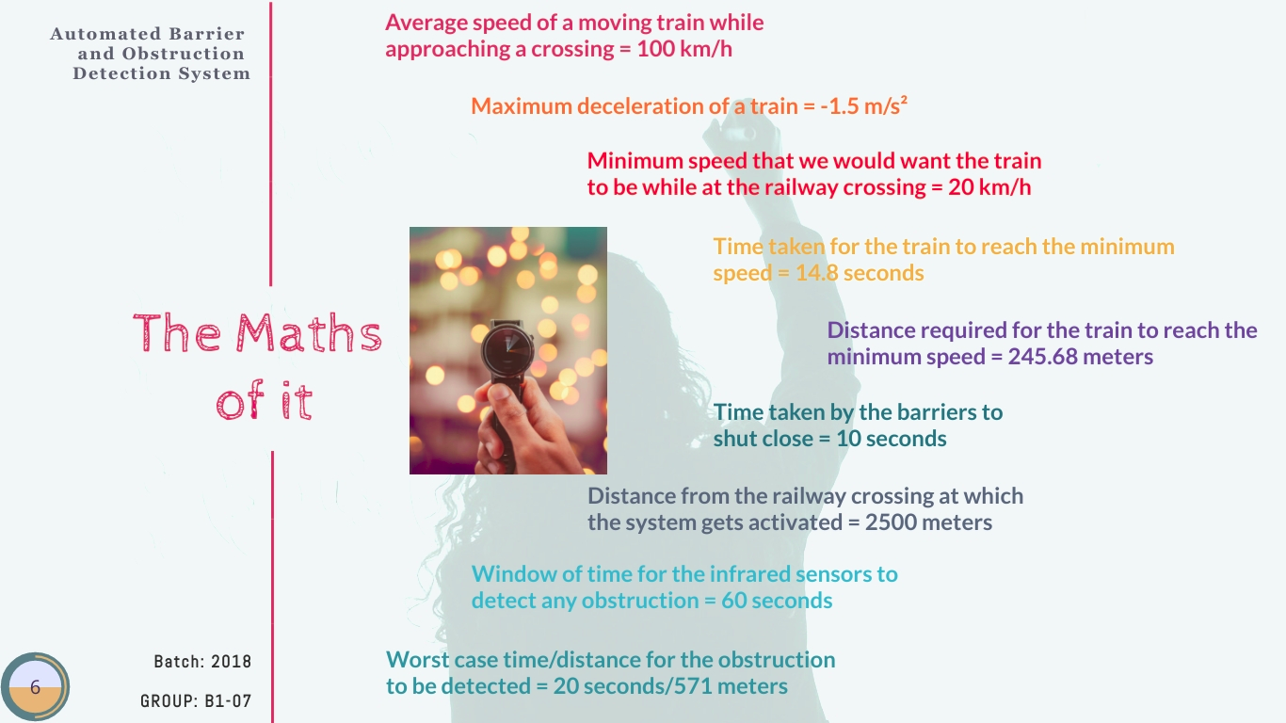

Slide 11
PHASE 2
Purchasing the Components and creating the initial MVP.

Slide 12
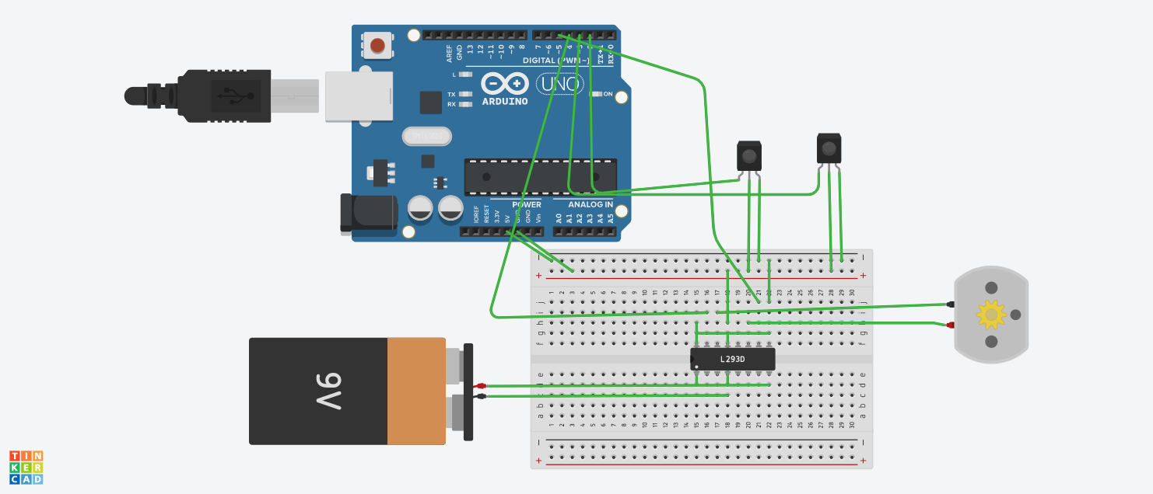
MVP Circuit Diagram

Slide 13
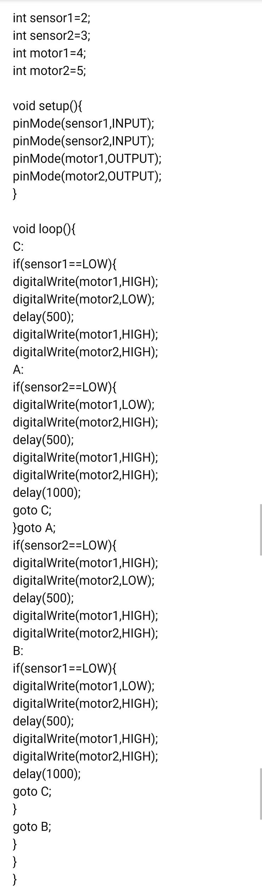
The code

Slide 14

Working of the Product(so far)

Slide 15
What else is left to do?
Working on real time obstacle detection at the railway crossing using IR sensor.
Implementation of an alarm alerting system at the crossing after detecting an obstruction.
Complete simulation of the model with a train set.

Slide 16
THE END

